Slide 1
SMART GARBAGE MONITORING SYSTEM(SMART BIN)

Slide 2
CONTENTS
INTRODUCTION
COMPONENTS USED
WORKING
APPLICATION
CONCLUSION

Slide 3
INTRODUCTION
One of the main concerns with the environment has been solid waste management which impacts health and environment of our society. The detection ,monitoring and management of wastage is one of the primary problems of the present era.
The traditional way of monitoring the wastes in the waste bins is a cumbersome process and utilizes more human effort which can be avoided with our project.

Slide 4
COMPONENTS
ARDUINO UNO
NODE MCU (Esp8266-12E)
ULTRASONIC SENSOR
DHT-11

Slide 5
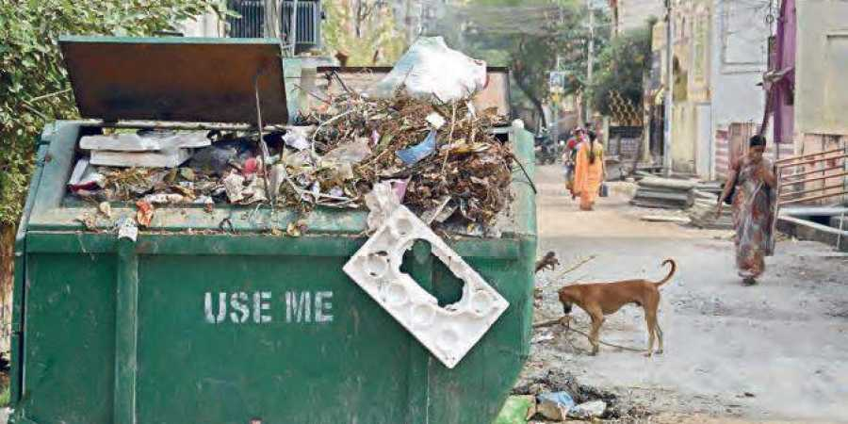



WORKING

Slide 6
APPLICATION
The information is captured by the ultrasonic and DHT-11 sensors with the help of Arduino uno.
The data is sent to the cloud through ESP8266-12E module.
The data(garbage levels, weather) present in the cloud is sent into the mobile application.

Slide 7
CONCLUSION
This project is easily deployable and can be manually or automatically done without physical presence at the place.
By this we can facilitate continuous monitoring and reporting, can reduce the cost and labour work,

